Slide 1
Object Oriented Software Engineering (OOSE)
22CS017
Building Analysis Model
By
Dr. Suvarna Sharma

Slide 2
Index
Building Analysis Model
Requirement Engineering
Data Modelling Concepts
Flow Oriented Modelling

Slide 3
Building Analysis Model

Slide 4
Analysis Modelling
At a technical level, software engineering begins with a series of modelling tasks that lead to a complete specification of requirements and a comprehensive design representation for the software to be built.
Analysis Model is a technical representation of the system. It acts as a link between system description and design model.
Objectives of Analysis Modelling:
It must establish a way of creating software design.
It must describe the requirements of the customer.
It must define a set of requirements that can be validated, once the software is built.

Slide 5
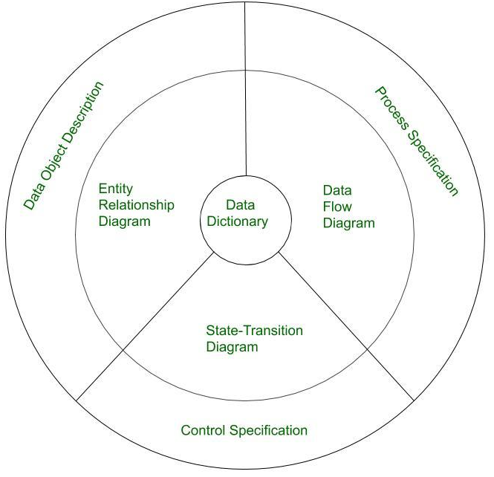
Elements of Analysis Model
Fig. 1 Elements of Analysis Model

Slide 6
Elements of Analysis Modelling (contd.)
1. Data Dictionary:
It is a very crucial element of the analysis model.
It is a repository that consists of a description of all data objects used or produced by the software.
It stores the collection of data present in the software.
It acts as a centralized repository and also helps in modeling data objects defined during software requirements.

Slide 7
Elements of Analysis Modelling (contd.)
2. Entity Relationship Diagram (ERD):
It depicts the relationship between data objects and is used in conducting data modeling activities.
The attributes of each object in the Entity-Relationship Diagram can be described using Data object description.
It provides the basis for activity related to data design.

Slide 8
Elements of Analysis Modelling (contd.)
3. State Transition Diagram:
It shows various modes of behavior (states) of the system and also shows the transitions from one state to another state in the system.
It also provides the details of how the system behaves due to the consequences of external events.
It represents the behavior of a system by presenting its states and the events that cause the system to change state.
It also describes what actions are taken due to the occurrence of a particular event.

Slide 9
Elements of Analysis Modelling (contd.)
4. Data Flow Diagram (DFD):
It depicts the functions that transform data flow and it also shows how data is transformed when moving from input to output.
It provides the additional information which is used during the analysis of the information domain and serves as a basis for the modeling of function.
It also enables the engineer to develop models of functional and information domains at the same time.

Slide 10
Elements of Analysis Modelling (contd.)
5. Process Specification (PSPEC):
It stores the description of each function present in the data flow diagram.
It describes the input to a function, the algorithm that is applied for the transformation of input, and the output that is produced.
It also shows regulations and barriers imposed on the performance characteristics that are applicable to the process and layout constraints that could influence the way in which the process will be implemented.

Slide 11
Elements of Analysis Modelling (contd.)
6. Control Specification (CSPEC):
It stores additional information about the control aspects of the software.
It is used to indicate how the software behaves when an event occurs and which processes are invoked due to the occurrence of the event.
It also provides the details of the processes which are executed to manage events.

Slide 12
Elements of Analysis Modelling (contd.)
7. Data Object Description:
It stores and provides complete knowledge about a data object present and used in the software.
It also gives us the details of attributes of the data object present in the Entity Relationship Diagram.
Hence, it incorporates all the data objects and their attributes.

Slide 13
Requirement Engineering
Requirement Engineering is the process of defining, documenting and maintaining the requirements.
It includes the following processes:
Feasibility Study
Requirement Elicitation and Analysis
Software Requirement Specification
Software Requirement Validation
Software Requirement Management

Slide 14
Feasibility Study
The objective behind the feasibility study is to create the reasons for developing the software that is acceptable to users, flexible to change and conformable to established standards.
Types of Feasibility:
Technical Feasibility - It evaluates the current technologies, which are needed to accomplish customer requirements within the time and budget.
Operational Feasibility - It assesses the range in which the required software performs a series of levels to solve business problems and customer requirements.
Economic Feasibility - It decides whether the necessary software can generate financial profits for an organization.

Slide 15
Requirement Elicitation and Analysis
Requirements Elicitation: This is the process of gathering information about the needs and expectations of stakeholders for the software system. This step involves interviews, surveys, focus groups, and other techniques to gather information from stakeholders.
Requirements Analysis: This step involves analyzing the information gathered in the requirements elicitation step to identify the high-level goals and objectives of the software system. It also involves identifying any constraints or limitations that may affect the development of the software system.

Slide 16
Requirement Elicitation and Analysis
There are several techniques that can be used to elicit requirements, including:
Interviews: These are one-on-one conversations with stakeholders to gather information about their needs and expectations.
Surveys: These are questionnaires that are distributed to stakeholders to gather information about their needs and expectations.
Focus Groups: These are small groups of stakeholders who are brought together to discuss their needs and expectations for the software system.
Observation: This technique involves observing the stakeholders in their work environment to gather information about their needs and expectations.
Prototyping: This technique involves creating a working model of the software system, which can be used to gather feedback from stakeholders and to validate requirements.

Slide 17
Problems of Elicitation and Analysis
Getting all, and only, the right people involved.
Stakeholders often don't know what they want
Stakeholders express requirements in their terms.
Stakeholders may have conflicting requirements.
Requirement change during the analysis process.
Organizational and political factors may influence system requirements.

Slide 18
Software Requirement Specification (SRS)
Software requirement specification is a kind of document which is created by a software analyst after the requirements are collected from the various sources - the requirement received by the customer written in ordinary language.
It is the job of the analyst to write the requirement in technical language so that they can be understood and beneficial by the development team.
The models used at this stage include Entity-Relationship (ER) diagrams, data flow diagrams (DFDs), function decomposition diagrams (FDDs), data dictionaries.

Slide 19
Software Requirement Specification (SRS)
1. Data Flow Diagrams (DFDs):
They are used widely for modeling the requirements.
DFD shows the flow of data through a system.
The system may be a company, an organization, a set of procedures, a computer hardware system, a software system, or any combination of the preceding.
The DFD is also known as a data flow graph or bubble chart.

Slide 20
Software Requirement Specification (SRS)
2. Data Dictionaries:
They are simply repositories to store information about all data items defined in DFDs.
At the requirements stage, the data dictionary should at least define customer data items, to ensure that the customer and developers use the same definition and terminologies.

Slide 21
Software Requirement Specification (SRS)
3. Entity-Relationship Diagrams:
Another tool for requirement specification is the entity-relationship diagram, often called an "E-R diagram."
It is a detailed logical representation of the data for the organization and uses three main constructs i.e. data entities, relationships, and their associated attributes.

Slide 22
Features of SRS
User Requirements are expressed in natural language.
Technical requirements are expressed in structured language, which is used inside the organization.
Design description should be written in Pseudo code.
Format of Forms and GUI screen prints.
Conditional and mathematical notations for DFDs etc.

Slide 23
Software Requirement Validation
After requirement specifications are developed, the requirements mentioned in this document are validated.
The user might demand illegal, impossible solution or experts may misinterpret the needs.
Requirements can be checked against following conditions -
If they can be practically implemented
If they are valid and as per functionality and domain of software
If there are any ambiguities
If they are complete
If they can be demonstrated

Slide 24
Software Requirement Validation - Techniques
Requirements reviews/inspections: systematic manual analysis of the requirements.
Prototyping: Using an executable model of the system to check requirements.
Test-case generation: Developing tests for requirements to check testability.
Automated consistency analysis: Checking for the consistency of structured requirements descriptions.

Slide 25
Software Requirement Management
Requirement management is the process of managing changing requirements during the requirements engineering process and system development.
New requirements emerge during the process as business needs a change, and a better understanding of the system is developed.
The priority of requirements from different viewpoints changes during development process.
The business and technical environment of the system changes during the development.

Slide 26
What is a Data Object?
Object
—something that is described by a set
of attributes (data items) and that will be
manipulated within the software (system)
object: automobile
attributes:
make
model
body type
price
options code
each
instance
of an object (e.g., a book)
can be identified uniquely (e.g., ISBN #)
each plays a necessary role in the system
i.e., the system could not function without
access to instances of the object
each is described by attributes that are
themselves data items

Slide 27
Data Modeling Concept
examines data objects independently of processing
focuses attention on the data domain
creates a model at the customer’s level of abstraction
indicates how data objects relate to one another

Slide 28
What is a Relationship?
Relationship:- indicates “connected”; a “fact” that must be “remembered” by the system and cannot or is not computed or derived mechanically
several instances of a relationship can exist
objects can be related in many different ways

Slide 29
ERD Notation
One common form:
(0, m)
object
relationship
object
1
(1, 1)
2
attribute
Another common form:
object
relationship
object
1
2
(0, m)
(1, 1)
Fig. 2 ERD Model

Slide 30
The ERD: An Example
request
for service
Customer
places
(1,1)
(1,m)
(1,1)
standard
task table
generates
(1,n)
work
order
(1,1)
(1,1)
(1,1)
selected
from
work
tasks
(1,w)
consists
of
(1,w)
(1,i)
materials
lists
Fig. 3 Example of ERD

Slide 31
Flow Oriented Modelling
It shows how data objects are transformed by processing the function.
The Flow oriented elements are:
Data flow model:
It is a graphical technique. It is used to represent information flow.
The data objects are flowing within the software and transformed by processing the elements.
The data objects are represented by labeled arrows. Transformation are represented by circles called as bubbles.
DFD shown in a hierarchical fashion. The DFD is split into different levels. It also called as 'context level diagram.

Slide 32
Flow Oriented Modelling (contd.)
2. Control flow model:
Large class applications require a control flow modeling.
The application creates control information instead of reports or displays.
The applications process the information in specified time.
An event is implemented as a boolean value.
For example, the boolean values are true or false, on or off, 1 or 0.
3. Control Specification (SPEC):
It represents the behavior of the system.
The state diagram in CSPEC is a sequential specification of the behavior.
The state diagram includes states, transitions, events and activities.
State diagram shows the transition from one state to another state if a particular event has occurred.

Slide 33
Flow Oriented Modelling (contd.)
4. Process Specification (PSPEC):
The process specification is used to describe all flow model processes.
The content of process specification consists narrative text, Program Design Language(PDL) of the process algorithm, mathematical equations, tables or UML activity diagram.

Slide 34
Practice Questions
Explain the primary objectives of analysis modelling in software engineering. Why is it considered a critical step in the development process?
Describe the significance of an Entity-Relationship Diagram (ERD) in analysis modelling. How do attributes and relationships contribute to the completeness of an ERD? Provide an example.
What are the challenges faced during the requirement elicitation and analysis process? Suggest strategies to overcome at least two of these challenges.
Discuss the different types of feasibility studies conducted during requirement engineering. How does each type influence the decision to proceed with a software project?
Compare and contrast Data Flow Diagrams (DFDs) and State Transition Diagrams (STDs). How does each diagram contribute to understanding different aspects of a software system?

Slide 35
THANKS

